Slide 1
Cell Membrane Transport: Active Transport (part 1 of 2)
Lecture 10

Slide 2
Objectives
Understand/know/focus on/note
the fundamental concept of active transport and how ATP is involved
direct versus coupled (indirect) active transport
what substances are transported this way
types of pumps (ATPases): where they are and what role they play
what the ABC-type ATPases are & what they do
the mechanism of the Na/K ATPase (P-type protein) and what regulates it

Slide 3
Kinds of Transport
Passive transport or diffusion
Active transport
Exocytosis & Endocytosis
discussed later

Slide 4
"Transport" With The Concentration Difference
Passive Transport
hydrophobic/lipophilic substances
soluble in plasma membrane
pass through membrane without any pore
polar hydrophilic substances
impermeable to plasma membrane
pass through only with pore-forming transmembrane protein
"Transport" is really diffusion caused by a concentration difference: substance with a high concentration one one side of membrane diffuses to achieve maximal dispersal (even spacing of substance molecules) within the diffusible space/volume it has
2nd law of thermodynamics

Slide 5
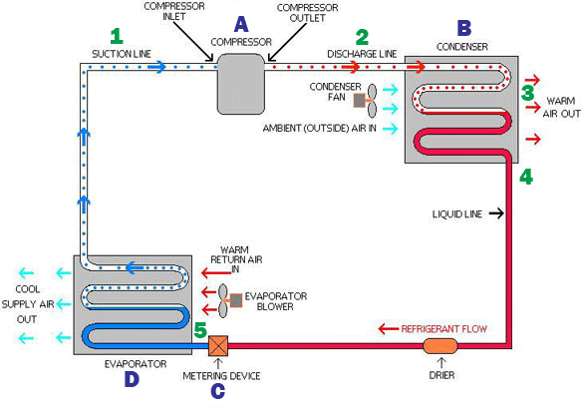
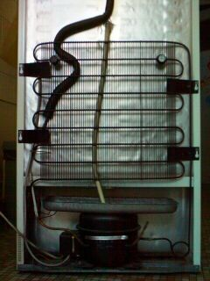
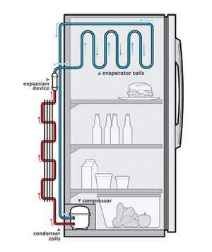
Heat Pumps & Refrigerators
Refrigerators utilize electrical energy to operate a pump (compressor) that compresses a gaseous refrigerant through coils on back of refrigerator
the cooler kitchen air causes the gas in coils to cool into liquid
this liquid refrigerant passes into the refrigerator inside
an expansion valve causes the liquid to form into a gas, drawing its heat for the phase change from the inside of the refrigerator, and thus cooling down the inside
the cycle starts over as the gas is compressed again back into a liquid

Slide 6
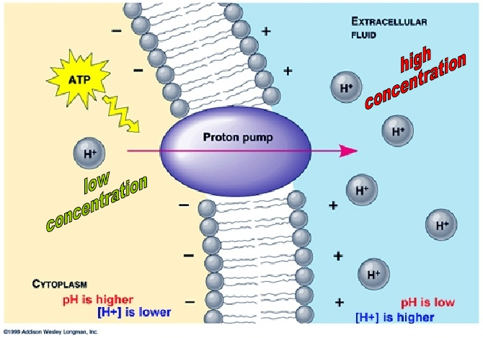
Transport Against The Concentration Difference
The refrigeration example shows how work is done to counter the dispersion of matter and energy
The cell uses its energy to counter
diffusion: high concentration → low concentration
active transport: low concentration → high concentration

Slide 7
The Energy Source
Adenosine Triphosphate (ATP)
the gas for the engine
High energy substances (glucose) generate ATP from usual metabolic pathways
ATP will interact with a domain or subunit on the protein with the transport role
Interaction will use the ATP → ADP + P_{i} reaction energy to drive a change in conformation (3°/tertiary structure) that results in ion pumping

Slide 8
Direct Active Transport
The term direct means that the ATP interacts with the transporting protein
This interaction usually involves ATP transferring the high energy phosphate (forming ADP as a product) to some part of the protein on one of its amino acids
This may put the protein into another physical state (conformational change)
When the phosphate is removed (hydrolyzed) from the protein, the protein returns to its original shape or conformational state, and the cycle can be started again

Slide 9
Coupled Active Transport
Also called secondary active transport
The transport protein does not derive its energy directly from ATP
It still requires energy, and the energy ultimately comes from the ATP → ADP + P_{i} reaction, but transport is driven by a chemical and/or electrical potential created across the membrane by an ATP-driven process (thus it is "coupled")

Slide 10
Coupled Transport Types
Transporters basically couple ATP hydrolysis (utilization of energy) to the movement of a substance (usually ion)
Cotransporters couple the energy in the concentration difference AND/OR the voltage across the cell membrane to the transport of a 2nd ion in the same direction of movement as the driving substance/ion
Cotransporters are called symporters
Exchangers couple energy to concentration differences AND/OR membrane voltage differences to the transport of a 2nd ion but in the opposite direction: they are called antiporters

Slide 11
Substances Transported Actively
directly or coupled
metal ions: Na⁺, K⁺, Ca²⁺, H⁺
organic cations /
lipophilic agents
toxic substances, drugs, xenobiotics: these can be a variety of water-soluble substances which are organic ions (cations or anions) or polar molecules, as well as lipophilic substances
anti-cancer chemotherapeutics especially

Slide 12
Active Transport Pumps (Animal Cells)
Plasma Membrane Transporters
Na⁺/K⁺ ATPase
Multidrug Resistance Efflux Transporters
H⁺/K⁺ (used to pump H⁺ into stomach to acidify)
Ca²⁺ ATPase: used by muscle to pump out Ca²⁺ into sarcoplasmic reticulum to stop contraction
Organelle Membrane Pumps
Mitochondrial H⁺/ATPase
Lysosomal H⁺

Slide 13
ATPase Types
P-Type (phosphorylation)
these include variety of transporters, cotransporters, exchangers
V-Type (vacuole)
these pump H⁺ into the space of vacuoles to acidify them
F-type (factor)
these actually do the reverse: make ATP using H⁺ gradients
ABC-type (ATP-binding cassette)
these pump poisons/toxicants back out to where they tried to enter

Slide 14
P-Type ATPases
These are often single polypeptide transmembrane proteins
8-10 TM segments forming a pore wall in membrane
They work by ions loading from inside into a cavity of one subunit in the membrane, which triggers ATP transferring a phosphate to an aspartate side chain on one subunit, which triggers a twist in the protein to open to the outside, releasing the ions
Ions from outside now load into the cavity, triggering phosphate to be hydrolyzed (released), and this triggers a twist back to open the cavity to the inside, moving the ions in the cavity in

Slide 15
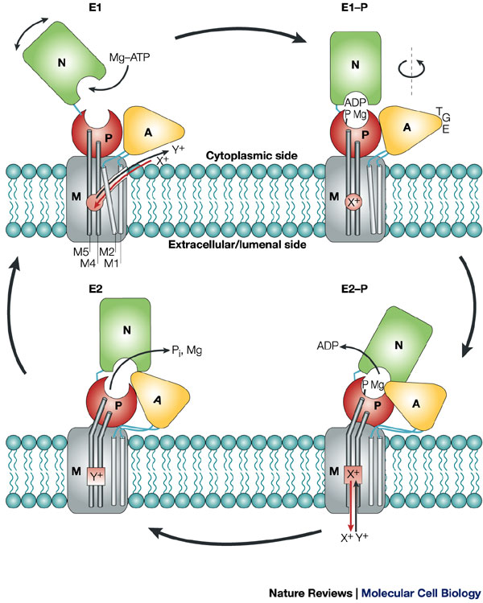
P-Type ATPase Mechanism
In upper left (E1 state), ion X⁺ moves from cytoplasm to bind to the membrane domain (M) high affinity site
This causes the phosphorylation domain (P) to move to its E1 conformation
Mg-ATP binds to the nucleotide-binding domain (N), then phosphorylates P on a key amino acid side chain, aspartate (Asp), now changing the protein to the E1-P state
The actuator (A) domain rotates causing a change from E1-P → E2-P, releasing the ADP.
A sequence of three amino acids, TGE (threonine-glycine-glutamic acid) on A domain is used to prevent the ATP from being reformed by a reverse of the phosphorylation step)
http://www.nature.com/nrm/journal/v5/n4/fig_tab/nrm1354_F6.html

Slide 16
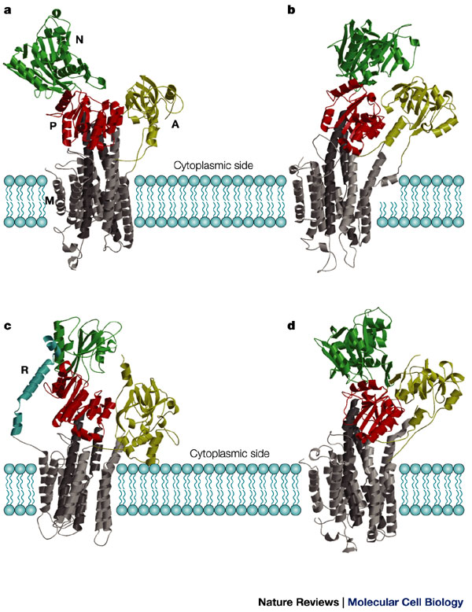
Reusability of Good Designs
Many proteins show homology (similarity, identity) in structure and function
This is particularly true of ATPases
This re-usability keeps a good function & makes slight changes to use new molecules / substrates
the figure at right shows three different P-Type ATPases
upper two are structures of a muscle Ca²⁺-ATPase in E1 (left) and E2 states
lower left is a yeast H⁺-ATPase in E1
lower right is duck Na⁺/K⁺-ATPase in E2
green (N) = ATP-binding domain
red (P) = phosphorylation domain
yellow (A) = actuator domain
grey (M) = transMembrane domain

Slide 17
ABC-Type ATPases
ABC = ATP-these serve a vital function in transporting out toxicants (poisons, xenobiotics) out of the cell
thus they are called multidrug-resistant (MDR) efflux transporters
multiple ABC-types are present in cells that have a primary function in detoxification
liver hepatocytes
GI tract mucosal epithelial cells
at least 150 different types in nature, with 48 different genes in humans
these can be single polypeptides with 4 domains or can be 4 separate polypeptides that have single functions
in bacteria, these proteins usually function as importers, not exporters (of nutrients)

Slide 18
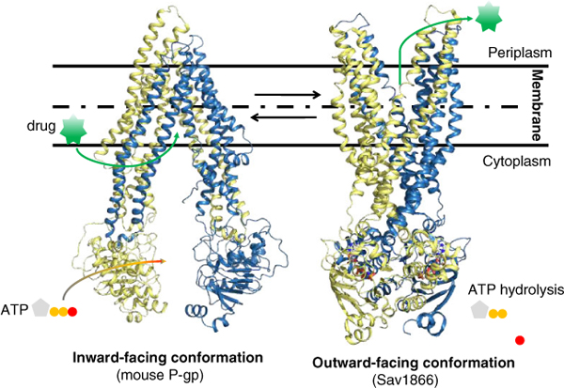
Structure-Function Similarities
While not exactly like P-type, ABC-type still have large parts of the protein on cytoplasmic side that bind and release energy from ATP
Additionally, they get the protein to twist to open a "mouth" from inside and outside to emit the drug/toxin
The transmembrane pore is formed by alpha helices just as in P-type, with about a half dozen helices making up the wall

Slide 19
V-Type/F-Type
V-Type
have two subunits: embedded membrane pore and peripheral subunit that has ATPase activity
these embed in the membranes of lysosomes, vacuoles, vesicles, endosomes, and Golgi complex
These pump protons (H⁺) into space to acidify it
F-Type
these have similarities in structure to other ATPases but have a different function
to be discussed later

Slide 20
The Na⁺/K⁺ ATPase
The sodium-potassium pump is perhaps the most significant ion pump in the cell
Its discovery and characterization were worthy of a Nobel Prize
A large fraction of a cell's energy goes to operating this antiporter, because it also drives other processes by coupled transport; over half the cell energy of a neuron is used to maintain sodium and potassium across the membrane so that it can transmit electrical impulses
Because it is so important, the details of the pump mechanism should be understood to some depth
Na/K pump is P-Type

Slide 21
MAJOR NOTE
The textually detailed step-by-step mechanism of Na⁺/K⁺-ATPase described in the slides that follow is the mechanism described by Horisberger in a 2004 review
This differs in one very important aspect from discussions found in biology & biochemistry textbooks:
The E2→E1 conformational change occurs according to Horisberger when ATP binds the protein
In textbooks, the E2→E1 conformational change occurs when the phosphate is hydrolyzed from the protein

Slide 22
Na/K ATPase Mechanism
At the start of the cycle, the Na⁺/K⁺ ATPase has an intracellular opening. This is called the E1 state of the pump. ATP is bound to the protein.
Na⁺ × 3 Binding. THREE (3) Na⁺ ions enter the pore space/cavity from the intracellular side and nestle inside the cavity.
ATP Phosphorylation. Na⁺ cations binding triggers the bound ATP molecule to transfer a phosphate to an amino acid side chain on an intracellular segment or loop of the protein. [That amino acid happens to be an aspartate (Asp), and it forms a acyl phosphate ester (–C(=O)–PO₃^{2–}), a quite common chemical modification.] The ADP product is released into the cytosol. This is the E1-P state of the protein.

Slide 23
Na/K ATPase Mechanism
Conformation Change. The act of transferring the phosphate to the polypeptide causes the transmembrane polypeptide to twist & turn. This twisting & turning shuts the intracellular "door" and opens the extracellular "door". The enzyme is now in the E2-P state.
Na⁺ ions exit. Because they have low affinity for the protein in the E2-P conformation, the 3 Na⁺ ions leave the cavity into the extracellular fluid
K⁺ ions enter. TWO (2) K⁺ ions now enter into the pore from the extracellular side, and occupy the cavity with high affinity

Slide 24
Na/K ATPase Mechanism
Dephosphorylation of protein. With the two K⁺ ions binding inside, this triggers a reaction that causes the acyl phosphate to be hydrolyzed: that is, a reaction in which H₂O eliminates the phosphate. The dephosphorylated protein is now in the E2 state
ATP binds. ATP binds (but does not transfer a phosphate!) to the protein.
Conformation change. With ATP binding, the protein twists and turns, going from the E2 to E1 state: the extracellular door is closed and the intracellular door opened.

Slide 25
Na/K ATPase Mechanism
K⁺ ions exit. With the intracellular door now open, the two K⁺ ions exit to the cytosol.
The cycle is complete, and can loop back to step 1.
The pump has achieved in one cycle the pumping out of 3 Na⁺ ions and pumping in 2 K⁺ ions, using one ATP molecule.

Slide 26
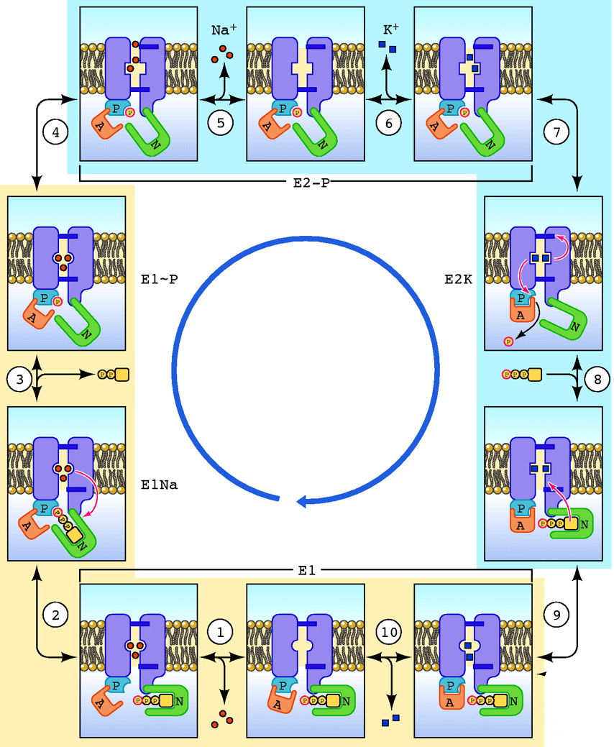
Na/K ATPase Mechanism
The steps textually describing the cycle in the previous slides are illustrated here to the right, published in 2004
Note that these steps are at odds with illustrations and descriptions in the biology texts and the animations.

Slide 27
Regulation of Na/K ATPase
The membrane protein can have its activity upregulated by increases in intracellular cAMP
cAMP is made by adenyl cyclase, the enzyme that was discussed as a downstream target of G-protein coupled receptor signaling. Thus G protein signaling that causes increases in cAMP concentration make the Na/K pump work more
There is a separate G protein signaling pathway that also decreases cAMP levels, so stimulating that pathway can downregulate Na/K pump activity

Slide 28
More Regulation of Na/K ATPase
Digoxin and ouabain are "cardiac glycosides" used to stimulate the pumping (contractility) of the heart
This happens because Ca²⁺ levels in heart muscle cells remain high instead of being pumped out quickly so that muscle can relax
Ca²⁺ is pumped out by a Na/Ca exchanger, which does not work unless the Na/K pump is working
These drugs/poisons actually affect the Na/K pump, and thereby affect the Na/Ca exchanger: slowing down or stopping the Na/K pump also does the same to the Na/Ca exchanger

Slide 29
Reading (Sources)
Na/K pump flash animation ← click here
http://highered.mheducation.com/sites/0072495855/student_view0/chapter2/animation__how_the_sodium_potassium_pump_works.html
Becker's WotC: Chapter 8 pp 208-216
Raven: Chap 5.5
Marieb: p 79

